Slide 1
Building Serverless Applications with Lambda

Slide 2

Overview
What is a serverless application?
How AWS Lambda works Serverless architectures
Demo: API Gateway and Lambda

Slide 3



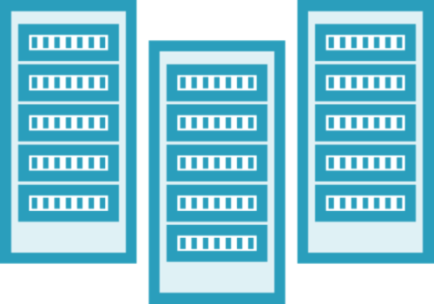
Serverless
No server management
Flexible scaling
High availability
No idle capacity

Slide 4
AWS Lambda
Compute layer for serverless
Functions
Code to execute
Configuration how to execute
Event sources (optional)
Always on, automatically scales Functions are stateless

Slide 5


Lambda Execution
Event Source

Slide 6




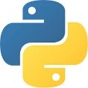




Creating Your Lambda Function
AWS Cloud
Native language support
Function code package
Stored in S3
Size limit
Lambda Layers
Zip archive
Keep code package small
Avoid dependency errors
Lambda
S3 bucket
Lambda runtime
+ API

Slide 7
Lambda Pricing
100ms increments
Rate based on memory allocation
CPU and network capacity
Increase as allocate more memory
Test and measure
Memory settings to optimize execution cost

Slide 8
Lambda with S3 and SNS
Object
S3
Data
SNS

Slide 9


Lambda with SQS and Kinesis
SQS Queue
Message
Data
Kinesis Data Streams

Slide 10



Lambda with Lex and Cloudwatch
Chatbot
Lex
Event (time-based)
CloudWatch
(cron replacement)

Slide 11
Amazon API Gateway
HA, scalable, managed service for APIs
Authentication and authorization
Throttling, metering, caching
Manage requests / responses
Lambda functions
Key component for serverless web apps
Meets serverless criteria

Slide 12






Serverless Developer Tools
AWS Serverless Architecture Model (SAM)
AWS, open source, third-party
Local Lambda environment
Shorthand syntax
CloudFormation templates
Access logs and metrics from deployed functions

Slide 13
AWS Serverless Application Repository
Managed serverless repository
Browse serverless applications
Publish your own application IAM resource level access
Private
Specific AWS accounts
Share publicly

Slide 14

Demo
AWS Serverless Application Repository
Deploy serverless app
CloudFormation API Gateway
Calls Lambda function

Slide 15
Stop and Start Amazon EC2 instances using Lambda
To stop and start EC2 instances at regular intervals using Lambda, do the following:
1. Create a custom AWS Identity and Access Management (IAM) policy and execution role for your Lambda function.
2. Create Lambda functions that stop and start your EC2 instances.
3. Test your Lambda functions.

Slide 16
Demo
Stop and Start Amazon EC2 instances using Lambda

Slide 17
Criteria for serverless applications
Lambda is compute component
Summary
Using with other AWS services
How Lambda functions work
AWS Serverless Application Repository
API Gateway to trigger Lambda

